Slide 1
Systems Analysis (Ch. 4)

Slide 2

Key Definitions
The As-Is system is the current system and may or may not be computerized
The To-Be system is the new system that is based on updated requirements

Slide 3
Key Ideas
The goal of the analysis phase is to truly understand the requirements of the new system and develop a system that addresses them -- or decide a new system isn’t needed.
The line between systems analysis and systems design is very blurry.

Slide 4
THE ANALYSIS PROCESS

Slide 5
Proposal Outline
Table of contents
Executive summary
System request
Work plan
Analysis strategy
Recommended system
Feasibility analysis
Process model
Data Model
Appendices

Slide 6
Three Steps of the Analysis Phase
Understanding the “As-Is” system
Identifying improvement opportunities
Developing the “To-Be” system concept

Slide 7
Three Fundamental Analysis Strategies
Business process automation (BPA)
Business Process Improvement (BPI)
Business Process Reengineering (BPR)

Slide 8
BUSINESS PROCESS AUTOMATION

Slide 9
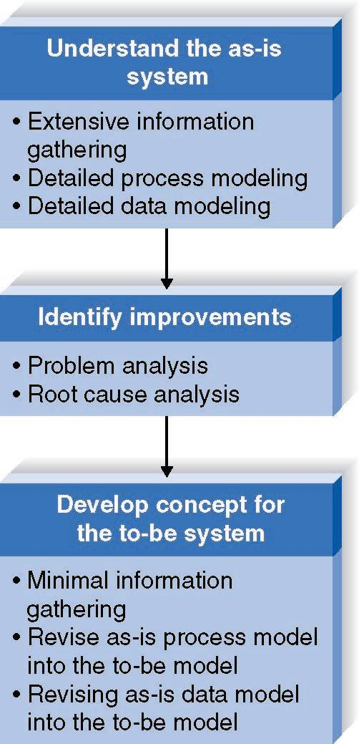
Business Process Automation
Goal:
Efficiency
for users

Slide 10

Identifying Improvements in As-Is Systems
Problem Analysis
  Asking users to identify problems
  Rarely finds significant monetary benefits
Root Cause Analysis
  Prioritizing problems
  Tracing symptoms to their causes

Slide 11
BUSINESS PROCESS IMPROVEMENT

Slide 12
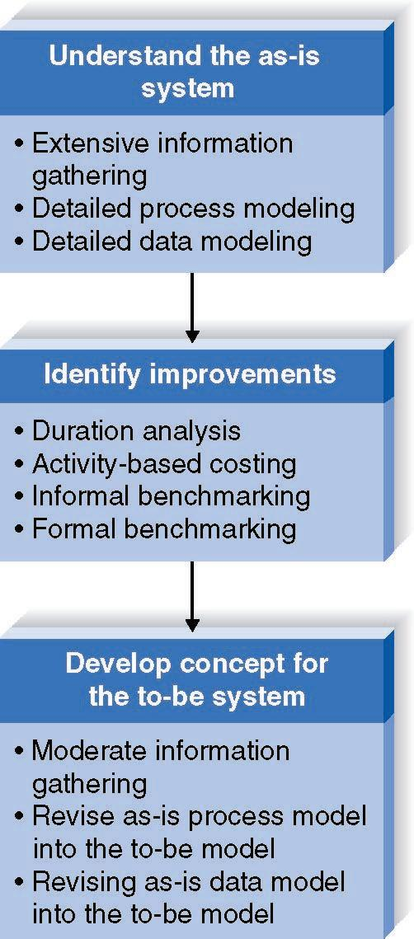
Business Process Improvement

Slide 13
Duration Analysis
Calculate time needed for each process step
Calculate time needed for overall process
Compare the two
Develop process integration or parallelization

Slide 14
Activity-Based Costing
Calculate cost of each process step
Consider both direct and indirect costs
Identify most costly steps and focus improvement efforts on them

Slide 15
Benchmarking
Studying how other organizations perform the same business process
Informal benchmarking
  Check with customers
Formal benchmarking
  Establish formal relationship with other organization

Slide 16
BUSINESS PROCESS REENGINEERING

Slide 17
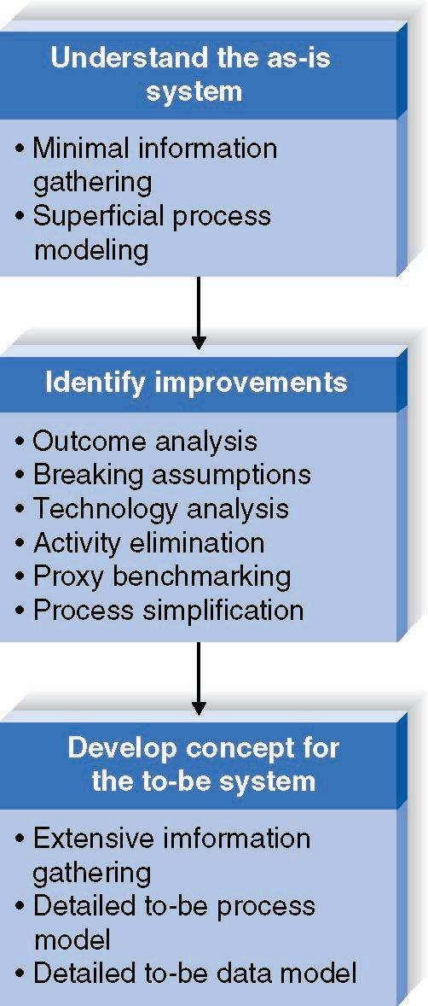
Business Process Reengineering
Radical
redesign
of
business
processes

Slide 18
Outcome Analysis
Consider desirable outcomes from customers’ perspective
Consider what the organization could enable the customer to do

Slide 19
Breaking Assumptions
Identify fundamental business rules
Systematically break each rule
Identify effects on the business if rule is broken

Slide 20
Technology Analysis
Analysts list important and interesting technologies
Managers list important and interesting technologies
The group identifies how each might be applied to the business

Slide 21
Activity Elimination
Identify what would happen if each organizational activity were eliminated
Use “force-fit” to test all possibilities

Slide 22
Proxy Benchmarking
List similar industries
Look for techniques from other industries that could be applied by the organization

Slide 23
Process Simplification
Eliminate complexity from routine transactions.
Design simple processes that handle (80-90)% of the inputs.
Concentrate separate processes for complex inputs.

Slide 24
Avoiding Classic Analysis Mistakes
Reducing analysis time
Requirement gold-plating
  User over-specification of features
Developer gold-plating
  Too many “cool” features
Lack of user involvement

Slide 25
DEVELOPING AN ANALYSIS PLAN

Slide 26
Developing an Analysis Strategy
Potential business value
Project cost
Breadth of analysis
Risk

Slide 27
Characteristics of Analysis Strategies
Business Business Business
Process Process Process
Automation Improvement Reeingineering
Potential Business Low-Moderate Moderate High
Value
Project Cost Low Low-Moderate High
Breadth of
Analysis Narrow Narrow-Moderate Very Broad
Risk Low-Moderate Low-Moderate Very High

Slide 28
Analysis Plan
Understanding the as-is system
  Review documentation
Identifying improvements
  Informal benchmarking
  Problem analysis
  Technology analysis
  Outcome analysis
Developing a to-be system concept
  Develop process model
  Develop data model

Slide 29
Summary
The analysis process aims to create value for the organization
Three main analysis strategies are BPA, BPI, and BPR
These strategies vary in potential business value, but also in potential cost and risk

Slide 30
Gathering Information (CH. 5)

Slide 31
Information Gathering
Needed to perform any analysis step
Five Techniques
  Interviews
  Questionnaire
  Document Analysis
  Observation
  JAD
When to use each technique?

Slide 32
Interviews

Slide 33
Interviews -- Five Basic Steps
Selecting Interviewees
Designing Interview Questions
Preparing for the Interview
Conducting the Interview
Post-Interview Follow-up

Slide 34
1.Selecting Interviewees
Based on Information Needed
Often Good to Get Different Perspectives
  Managers
  Users
  Ideally, All Key Stakeholders
Develop an interview schedule

Slide 35
Types of Questions
Types of Questions
Examples
Closed-Ended Questions
* How many telephone
orders are received per day?
* How do customers place orders?
* What additional information
would you like the new system
to provide?
Open-Ended Questions
* What do you think about the
current system?
* What are some of the problems
you face on a daily basis?
* How do you decide what types of
marketing campaign to run?
Probing Questions
* Why?
* Can you give me an example?
* Can you explain that in a bit
more detail?

Slide 36
2.Designing Interview Questions
Unstructured interview
  Broad, Roughly Defined Information
  (open ended questions)
Structured interview
  More Specific Information (closed ended info)

Slide 37
3.Interview Preparation Steps
Prepare General Interview Plan
  List of Question
  Anticipated Answers and Follow-Ups
Confirm Areas of Knowledge
Set Priorities in Case of Time Shortage
Prepare the Interviewee
  Schedule
  Inform of Reason for Interview
  Inform of Areas of Discussion

Slide 38
4.Conducting the Interview
Appear professional and unbiased
Record all information
Check on organizational policy regarding tape recording
Be sure you understand all issues and terms
Separate facts from opinions
Give interviewee time to ask questions
Be sure to thank the interviewee
End on time

Slide 39
Conducting the Interview
Practical Tips
Don’t Worry, Be Happy
Pay Attention
Summarize Key Points
Be Honest
Watch Body Language

Slide 40
5.Post-Interview Follow-Up
Prepare Interview Report
Look for Gaps and New Questions
Send and ask for corrections

Slide 41
Interview Report
INTERVIEW REPORT
Interview notes approved by: ____________
Person interviewed ______________
Interviewer _______________
Date _______________
Primary Purpose:
Summary of Interview:
Open Items:
Detailed Notes:

Slide 42
QUESTIONNAIRES
For systems used outside the
organization
Many people are asked for
information

Slide 43
Questionnaire Steps
Selecting participants
  Using samples of the population(30-50)% will respond
Designing the questionnaire
  Careful question selection
Administering the questionnaire
  Working to get good response rate
Questionnaire follow-up
  Send results to participants

Slide 44
Good Questionnaire Design
Begin with non-threatening and interesting questions
Group items into logically coherent sections
Do not put important items at the very end of the questionnaire
Do not crowd a page with too many items
Avoid abbreviations
Avoid biased or suggestive items or terms
Number questions to avoid confusion
Provide anonymity to respondents

Slide 45
Document Analysis
Provides clues about existing “as-is” system
Typical documents
  Forms
  Reports
Look for user additions to forms
Look for unused form elements

Slide 46
Observation
After Interviews and Quest., do observation
Users/managers often don’t remember everything they do
Checks validity of information gathered other ways
Behaviors change when people are watched
Careful not to ignore periodic activities
  Weekly … Monthly … Annual

Slide 47
Criteria for Selecting the Appropriate Techniques
Type of information
Depth of information
Breadth of information
Integration of information
User involvement
Cost
Combining techniques

Slide 48
Selecting the Appropriate Techniques
Interviews JAD Questionnaires Document Observation
Analysis
Type of As-Is As-Is As-Is As-Is As-Is
Information Improve. Improve. Improve.
To-Be To-Be
Depth of High High Medium Low Low
Information
Breadth of Low Medium High High Low
Information
Integration Low High Low Low Low
of Info.
User Medium High Low Low Low
Involvement
Cost Medium Low- Low Low Low-
Medium Medium

Slide 49
Summary
There are five major information gathering techniques that all systems analysts must be able to use: Interviews, JAD, Questionnaires, Document Analysis, and Observation.
Systems analysts must also know how and when to use each as well as how to combine methods.

